Slide 1
Database Management Using SQL

Slide 2
DBMS
DATABASE
The database is a collection of inter-related data which is used to retrieve, insert and delete the data efficiently. It is also used to organize the data in the form of a table, schema, views, and reports, etc.
For example: The college Database organizes the data about the admin, staff, students and faculty etc.
Using the database, you can easily retrieve, insert, and delete the information.

Slide 3
DATABASE MANAGEMENT SYSTEM
Database management system is a software which is used to manage the database. For example: MySQL, Oracle, etc are a very popular commercial database which is used in different applications.
DBMS provides an interface to perform various operations like database creation, storing data in it, updating data, creating a table in the database and a lot more.
It provides protection and security to the database. In the case of multiple users, it also maintains data consistency.

Slide 4
DBMS allows users the following tasks:
Data Definition:
It is used for creation, modification, and removal of definition that defines the organization of data in the database.
Data Updation:
It is used for the insertion, modification, and deletion of the actual data in the database.
Data Retrieval:
It is used to retrieve the data from the database which can be used by applications for various purposes.
User Administration:
It is used for registering and monitoring users, maintain data integrity, enforcing data security, dealing with concurrency control, monitoring performance and recovering information corrupted by unexpected failure.

Slide 5
Characteristics of DBMS
It uses a digital repository established on a server to store and manage the information.
It can provide a clear and logical view of the process that manipulates data.
DBMS contains automatic backup and recovery procedures.
It contains ACID properties which maintain data in a healthy state in case of failure.
It can reduce the complex relationship between data.
It is used to support manipulation and processing of data.
It is used to provide security of data.
It can view the database from different viewpoints according to the requirements of the user.

Slide 6
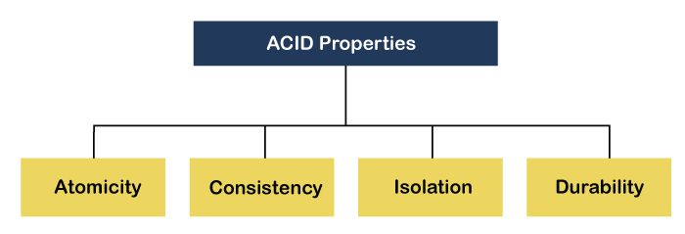

Slide 7
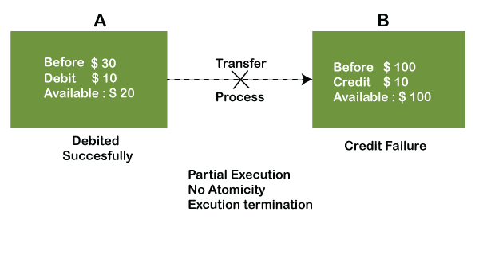
Atomicity:
The term atomicity defines that the data remains atomic.
It means if any operation is performed on the data, either it should be performed or executed completely or should not be executed at all.
It further means that the operation should not break in between or execute partially. In the case of executing operations on the transaction, the operation should be completely executed and not partially.

Slide 8
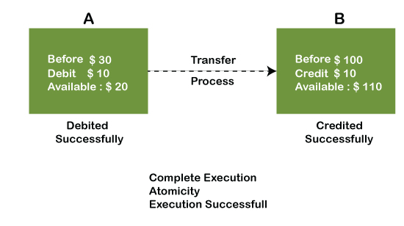
In the above diagram, it can be seen that after crediting $10, the amount is still $100 in account B. So, it is not an atomic transaction.
The below image shows that both debit and credit operations are done successfully. Thus the transaction is atomic.

Slide 9
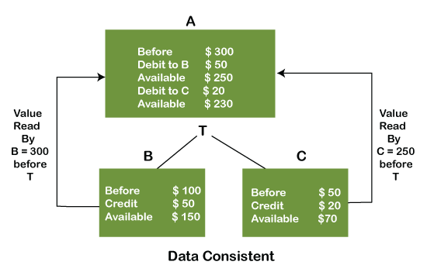
Consistency:
The word consistency means that the value should remain preserved always.
In DBMS, the integrity of the data should be maintained, which means if a change in the database is made, it should remain preserved always.
In the case of transactions, the integrity of the data is very essential so that the database remains consistent before and after the transaction. The data should always be correct.

Slide 10
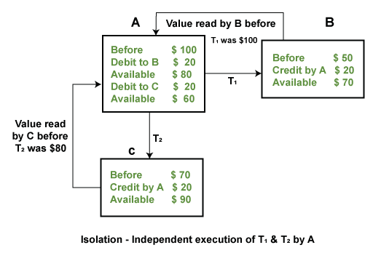
Isolation:
The term 'isolation' means separation.
In DBMS, Isolation is the property of a database where no data should affect the other one and may occur concurrently.
In short, the operation on one database should begin when the operation on the first database gets complete.
It means if two operations are being performed on two different databases, they may not affect the value of one another.
In the case of transactions, when two or more transactions occur simultaneously, the consistency should remain maintained.
Any changes that occur in any particular transaction will not be seen by other transactions until the change is not committed in the memory.

Slide 11
Durability:
Durability ensures the permanency of something.
In DBMS, the term durability ensures that the data after the successful execution of the operation becomes permanent in the database.
The durability of the data should be so perfect that even if the system fails or leads to a crash, the database still survives.
However, if gets lost, it becomes the responsibility of the recovery manager for ensuring the durability of the database. For committing the values, the COMMIT command must be used every time we make changes.

Slide 12
Advantages of DBMS
Controls database redundancy:
It can control data redundancy because it stores all the data in one single database file and that recorded data is placed in the database.
Data sharing:
In DBMS, the authorized users of an organization can share the data among multiple users.
Easily Maintenance:
It can be easily maintainable due to the centralized nature of the database system.
Reduce time:
It reduces development time and maintenance need.
Backup:
It provides backup and recovery subsystems which create automatic backup of data from hardware and software failures and restores the data if required.
Multiple user interface:
It provides different types of user interfaces like graphical user interfaces, application program interfaces

Slide 13
Disadvantages of DBMS
Cost of Hardware and Software:
It requires a high speed of data processor and large memory size to run DBMS software.
Size:
It occupies a large space of disks and large memory to run them efficiently.
Complexity:
Database system creates additional complexity and requirements.
Higher impact of failure:
Failure is highly impacted the database because in most of the organization, all the data stored in a single database and if the database is damaged due to electric failure or database corruption then the data may be lost forever.

Slide 14
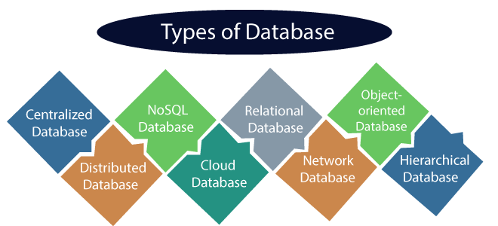

Slide 15
Centralized Database
It is the type of database that stores data at a centralized database system.
It comforts the users to access the stored data from different locations through several applications.
These applications contain the authentication process to let users access data securely.
An example of a Centralized database can be Central Library that carries a central database of each library in a college/university.
Distributed Database
Unlike a centralized database system, in distributed systems, data is distributed among different database systems of an organization. These database systems are connected via communication links.
Such links help the end-users to access the data easily. Examples of the Distributed database are Apache Cassandra, HBase, Ignite, etc.

Slide 16
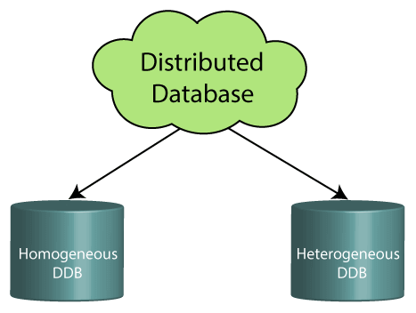
Homogeneous DDB:
Those database systems which execute on the same operating system and use the same application process and carry the same hardware devices.
Heterogeneous DDB:
Those database systems which execute on different operating systems under different application procedures, and carries different hardware devices.

Slide 17
Relational Database
This database is based on the relational data model, which stores data in the form of rows(tuple) and columns(attributes), and together forms a table(relation).
A relational database uses SQL for storing, manipulating, as well as maintaining the data. E.F. Codd invented the database in 1970.
Each table in the database carries a key that makes the data unique from others. Examples of Relational databases are MySQL, Microsoft SQL Server, Oracle, etc.
NoSQL Database
Non-SQL/Not Only SQL is a type of database that is used for storing a wide range of data sets.
It is not a relational database as it stores data not only in tabular form but in several different ways. It came into existence when the demand for building modern applications increased.
Thus, NoSQL presented a wide variety of database technologies in response to the demands.

Slide 18
Cloud Database
A type of database where data is stored in a virtual environment and executes over the cloud computing platform.
It provides users with various cloud computing services (SaaS, PaaS, IaaS, etc.) for accessing the database.
Object-oriented Databases
The type of database that uses the object-based data model approach for storing data in the database system.
The data is represented and stored as objects which are similar to the objects used in the object-oriented programming language.
Hierarchical Databases
It is the type of database that stores data in the form of parent-children relationship nodes. Here, it organizes data in a tree-like structure.
Data get stored in the form of records that are connected via links. Each child record in the tree will contain only one parent. On the other hand, each parent record can have multiple child records.

Slide 19
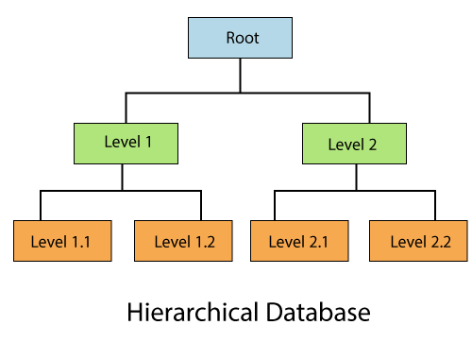

Slide 20
Network Databases
It is the database that typically follows the network data model.
Here, the representation of data is in the form of nodes connected via links between them.
Unlike the hierarchical database, it allows each record to have multiple children and parent nodes to form a generalized graph structure.
Personal Database
Collecting and storing data on the user's system defines a Personal Database. This database is basically designed for a single user.
Operational Database
The type of database which creates and updates the database in real-time.
It is basically designed for executing and handling the daily data operations in several businesses.
For example, An organization uses operational databases for managing per day transactions.

Slide 21
Enterprise Database
Large organizations or enterprises use this database for managing a massive amount of data.
It helps organizations to increase and improve their efficiency. Such a database allows simultaneous access to users.

Slide 22
DBMS Architecture
The DBMS design depends upon its architecture. The basic client/server architecture is used to deal with a large number of PCs, web servers, database servers and other components that are connected with networks.
The client/server architecture consists of many PCs and a workstation which are connected via the network.
DBMS architecture depends upon how users are connected to the database to get their request done.

Slide 23
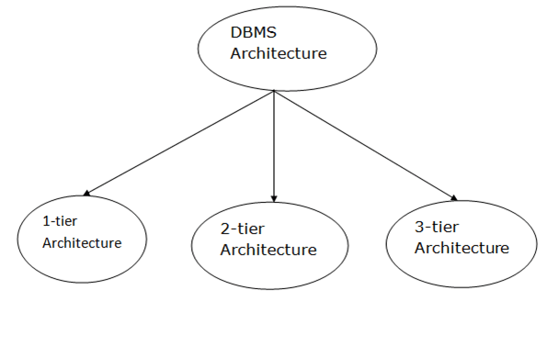

Slide 24
1-Tier Architecture
In this architecture, the database is directly available to the user. It means the user can directly sit on the DBMS and uses it.
Any changes done here will directly be done on the database itself. It doesn't provide a handy tool for end users.
The 1-Tier architecture is used for development of the local application, where programmers can directly communicate with the database for the quick response.
2-Tier Architecture
The 2-Tier architecture is same as basic client-server. In the two-tier architecture, applications on the client end can directly communicate with the database at the server side. For this interaction, API's like: ODBC, JDBC are used.
The user interfaces and application programs are run on the client-side.
The server side is responsible to provide the functionalities like: query processing and transaction management.
To communicate with the DBMS, client-side application establishes a connection with the server side.

Slide 25
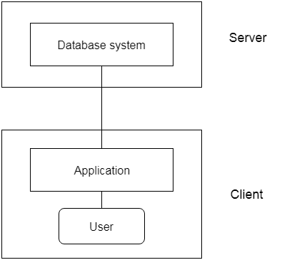

Slide 26
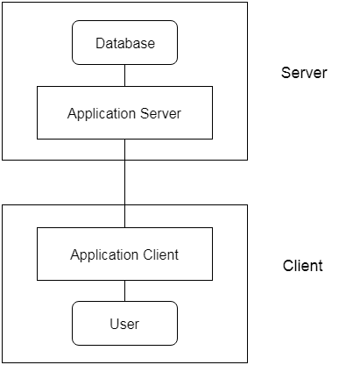
3-Tier Architecture
The 3-Tier architecture contains another layer between the client and server. In this architecture, client can't directly communicate with the server.
The application on the client-end interacts with an application server which further communicates with the database system.
End user has no idea about the existence of the database beyond the application server. The database also has no idea about any other user beyond the application.
The 3-Tier architecture is used in case of large web application.

Slide 27
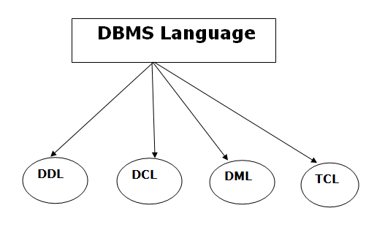
Database Language
A DBMS has appropriate languages and interfaces to express database queries and updates.
Database languages can be used to read, store and update the data in the database.

Slide 28
Data Definition Language
DDL stands for Data Definition Language. It is used to define database structure or pattern.
It is used to create schema, tables, indexes, constraints, etc. in the database.
Using the DDL statements, you can create the skeleton of the database.
Data definition language is used to store the information of metadata like the number of tables and schemas, their names, indexes, columns in each table, constraints, etc.
Data Manipulation Language
DML stands for Data Manipulation Language. It is used for accessing and manipulating data in a database. It handles user requests.
Data Control Language
DCL stands for Data Control Language. It is used to retrieve the stored or saved data.
The DCL execution is transactional. It also has rollback parameters.

Slide 29
Transaction Control Language
TCL is used to run the changes made by the DML statement. TCL can be grouped into a logical transaction.

Slide 30
STRUCTERED QUERY LANGUAGE
What is SQL?
SQL is a short-form of the structured query language, and it is pronounced as S-Q-L or sometimes as See-Quell.
This database language is mainly designed for maintaining the data in relational database management systems.
It is a special tool used by data professionals for handling structured data (data which is stored in the form of tables). It is also designed for stream processing in RDBMS.
You can easily create and manipulate the database, access and modify the table rows and columns, etc. This query language became the standard of ANSI in the year of 1986 and ISO in the year of 1987.

Slide 31
Why SQL?
Nowadays, SQL is widely used in data science and analytics. Following are the reasons which explain why it is widely used:
The basic use of SQL for data professionals and SQL users is to insert, update, and delete the data from the relational database.
SQL allows the data professionals and users to retrieve the data from the relational database management systems.
It also helps them to describe the structured data.
It allows SQL users to create, drop, and manipulate the database and its tables.

Slide 32
It also helps in creating the view, stored procedure, and functions in the relational database.
It allows you to define the data and modify that stored data in the relational database.
It also allows SQL users to set the permissions or constraints on table columns, views, and stored procedures.

Slide 33
RDBMS
RDBMS stands for Relational Database Management System.
All modern database management systems like SQL, MS SQL Server, IBM DB2, ORACLE, My-SQL, and Microsoft Access are based on RDBMS.
It is called Relational Database Management System (RDBMS) because it is based on the relational model introduced by E.F. Codd.

